Slide 1
Labor Economics Project. Returns to additional training
Petrakov Sergey, Semeneev Danat, Kuleshov Gleb

Slide 2
Questions
Problem
The price of additional education has grown substantially over last few decades, people may spend enormous sums of money on training without any evidence of significant payoff to their future earnings.
Does additional training affect future returns?
How does additional training affect individual wage?

Slide 3
Data
Cross-sectional data - RLMS 2015 year (10881 observations in General Model).
Restrictions on the dataset:
Respondents with no information about training omitted
‘Working’ respondents with no information on salary omitted
Respondents refusing to assess their skills with 0-9 scale omitted
Respondents refusing to call their education level omitted

Slide 4
Summary Statistics

Slide 5
General Model
Two-Stage Heckman procedure

Slide 6
Selection equation (analysis of the fact of work via the first stage of Heckman procedure)

Slide 7
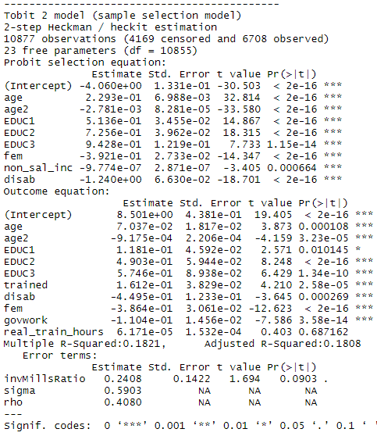
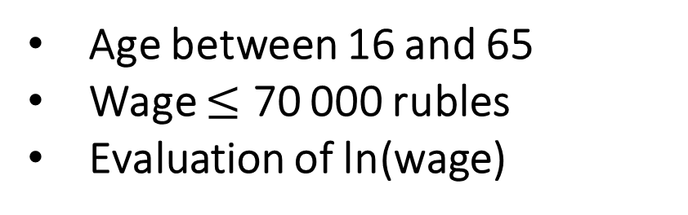
Extension 1. We refined our general model adding a variable for real training hours in regression
Restrictions imposed on dataset:
Age between 16 and 65
Wage $≤$ 70 000 rubles
Evaluation of ln(wage)
Collolaries: the real_train_hours variable is statistically
insignificant, while trained variable is significant at the 0,1% level

Slide 8
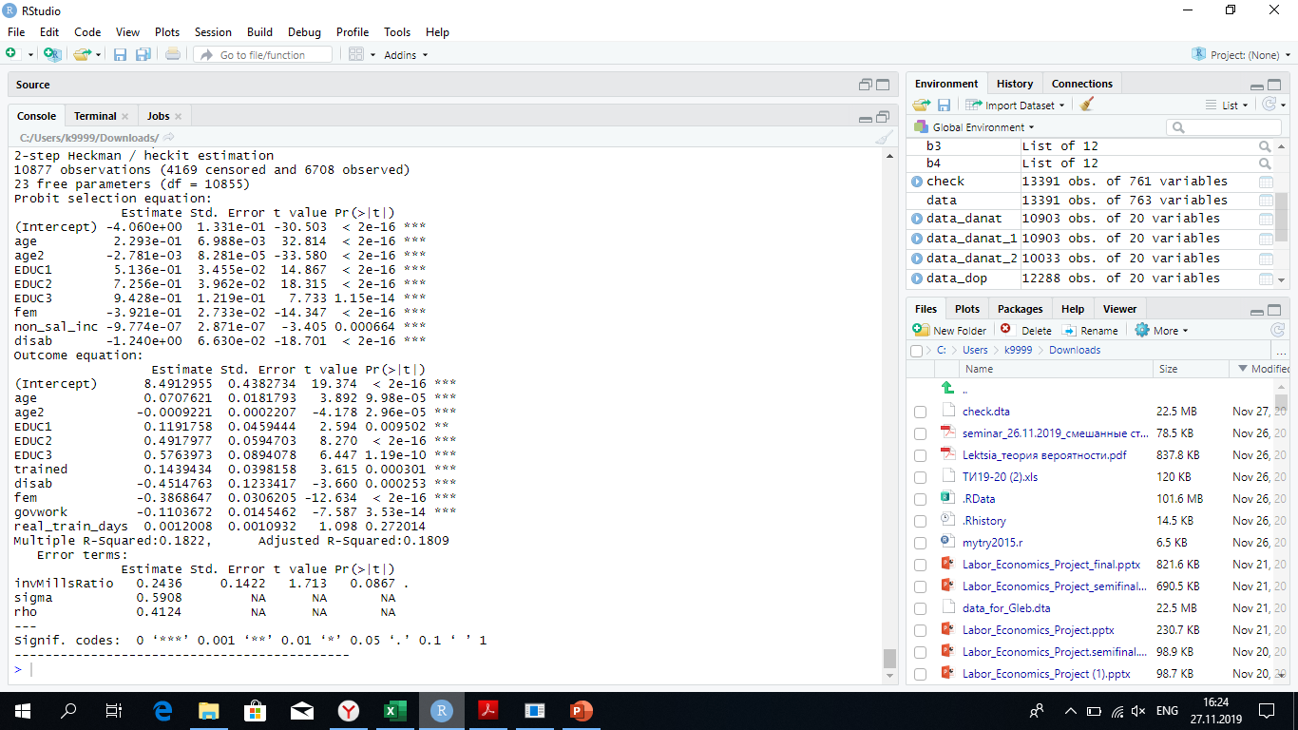
Extension 2. We refined our general model adding a variable for real training days in regression
Restrictions imposed on dataset:
Age between 16 and 65
Wage $≤$ 70 000 rubles
Evaluation of ln(wage)
Collolaries: the real_train_days variable is statistically
insignificant, while trained variable is significant at the 0,1% level

Slide 9
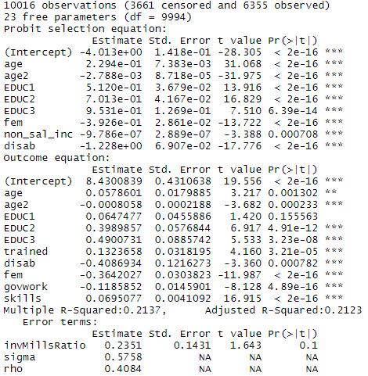
Extension 3. We added variable for real training days in regression
Restrictions imposed on dataset:
Age between 16 and 65
Wage $≤$ 70 000 rubles
Evaluation of ln(wage)
Collolaries: the skills variable is statistically
significant, and trained variable is significant at the 0,1% level. However, here is a high possibility of the endogeneity
of variable skills.

Slide 10
Training matters
Result

Slide 11
Theoretical basement
Behrman (1977) – skills
Ben-Porath Model – education & age
Heckman (1979) two stage procedure
Articles:
Brunello, Giorgio, On the Complementarity between Education and Training in Europe (June 2001).
Gerfin, Work-Related Training and Wages: An Empirical Analysis for Male Workers in Switzerland. (March 2004)

